Slide 1
Connection and Collaboration

Slide 2
Agenda
Who's who
Why we're here
What we're aiming to achieve
Careers after apprenticeships
Breakout rooms
Activity for the next six months
Notes:
12.05

Slide 3
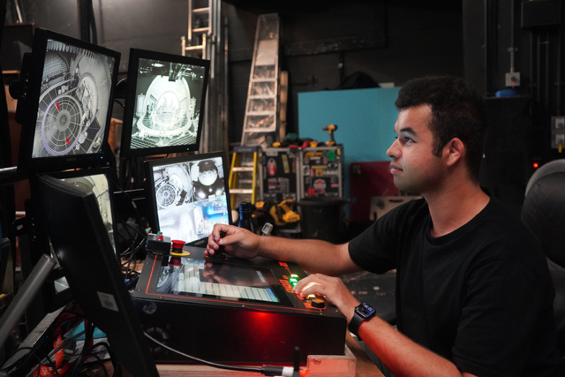
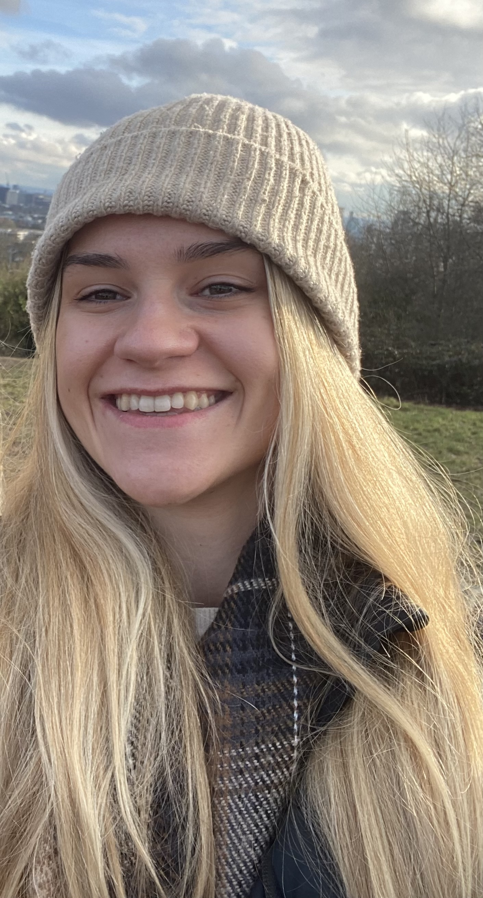
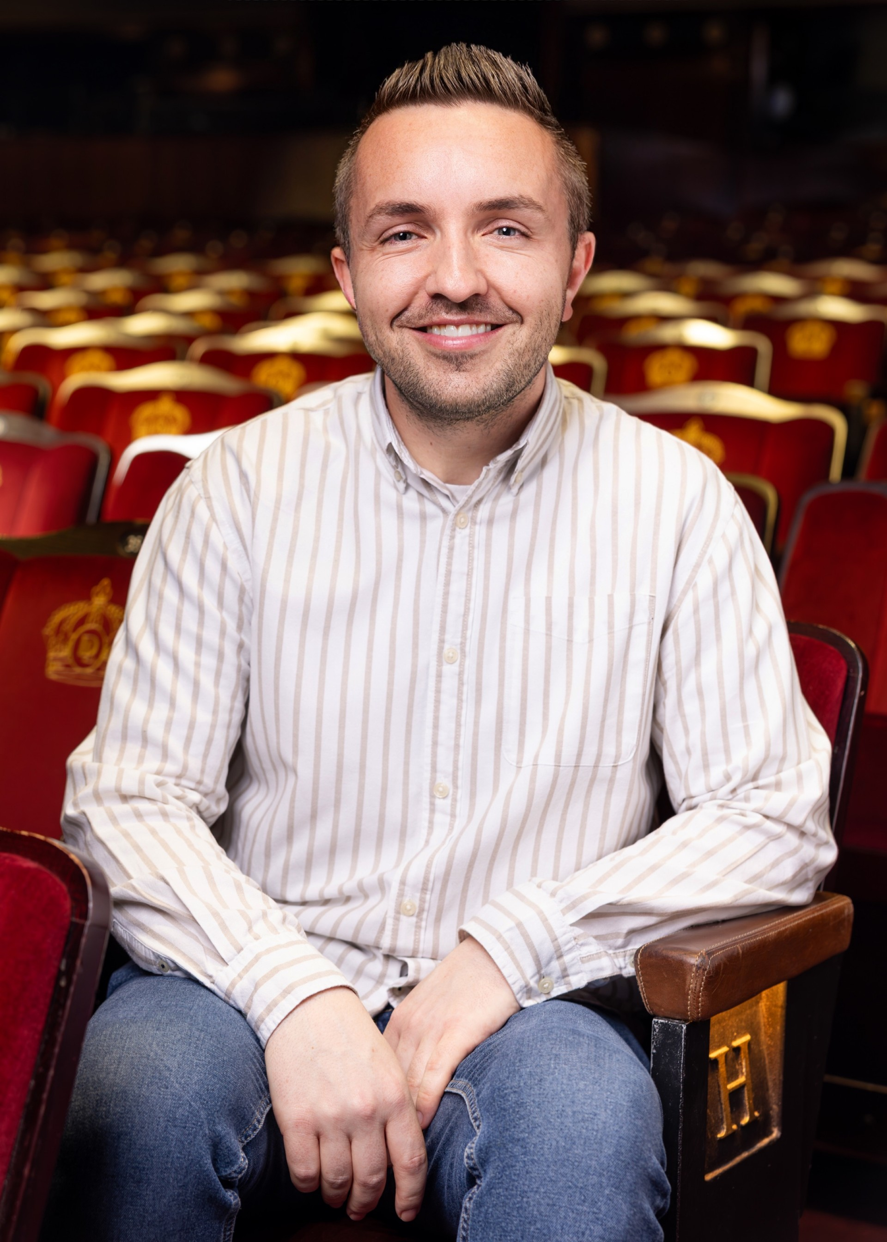
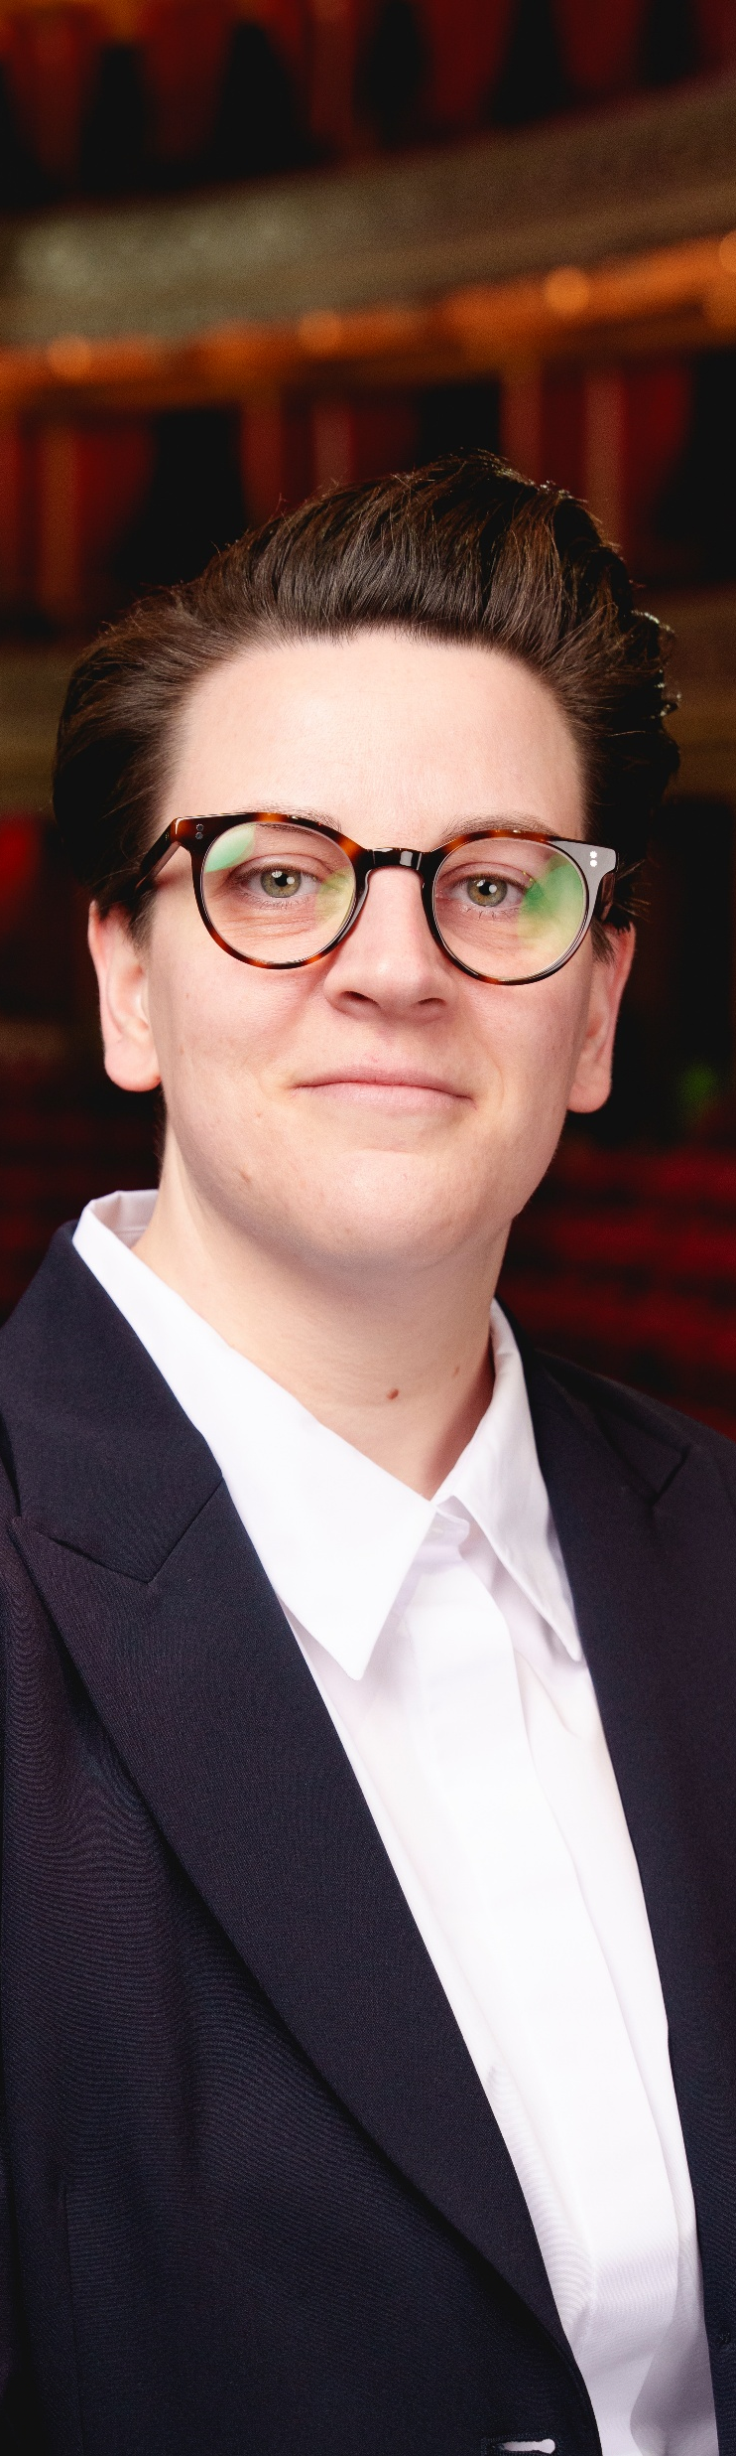
Who’s who

Slide 4
Who’s who
Hugo Blackwood
Creative Industries Production Technician Apprentice
Apprenticeship Network Chair (Apprentices)

Slide 5
Who’s who
Olivia Garner
Assistant Production Manager Apprentice
Apprenticeship Network
Vice Chair (Apprentices)

Slide 6
Who’s who
James Owen
Head of People Development
LW Theatres Group
Apprenticeship Network Chair (Employer)

Slide 7

Who’s who
Why we’re here
Olivia Sangster-Buller
Head of Production & Technical
Apprenticeship Network
Vice Chair
(Employer)

Slide 8
Who’s who – The Chairs
Why we’re here
Liv Sangster-Buller
Head of Production & Technical
Apprenticeship Network
Vice Chair
(Employer)
Build a community of apprentices and employers across the industry
Share experiences, challenges and good practice
Support apprentices during and after their apprenticeship
Create opportunities for networking, mentoring and peer support
Develop resources that help apprentices thrive
Strengthen progression pathways into long-term industry careers
Shape the future priorities of the ABTT Apprentice Network
Notes:
12.10
The ABTT Apprentice Network has been created to bring apprentices and employers together to build stronger connections, share experiences and support success across the technical theatre industry. The network provides a space to learn from one another, celebrate achievements and tackle the challenges that apprentices face throughout their apprenticeship journey and beyond.
By working together, we can identify the support that makes the greatest difference, create opportunities for mentoring and knowledge sharing, and help apprentices progress into long-term careers in our industry. This is not just a conversation for today. It is the foundation for a network that will develop resources, partnerships and practical support that benefit apprentices, employers and the wider sector.

Slide 9
What we're aiming to achieve
Connection and Collaboration
Support and Progression
Visibility and Sharing
Notes:
12.15
Connection
Networking events
Discussion forums
Ambassador roles
Apprentice database / buddying
Support & Progression
Mentorship / support programme
End-point assessment support
Support from ex-apprentices
Support for ex-apprentices
Wellbeing & accessibility
Visibility & Sharing
Celebrate apprentice stories
Newsletter / Digital Content
Promotion of apprenticeships
Shared resources

Slide 10
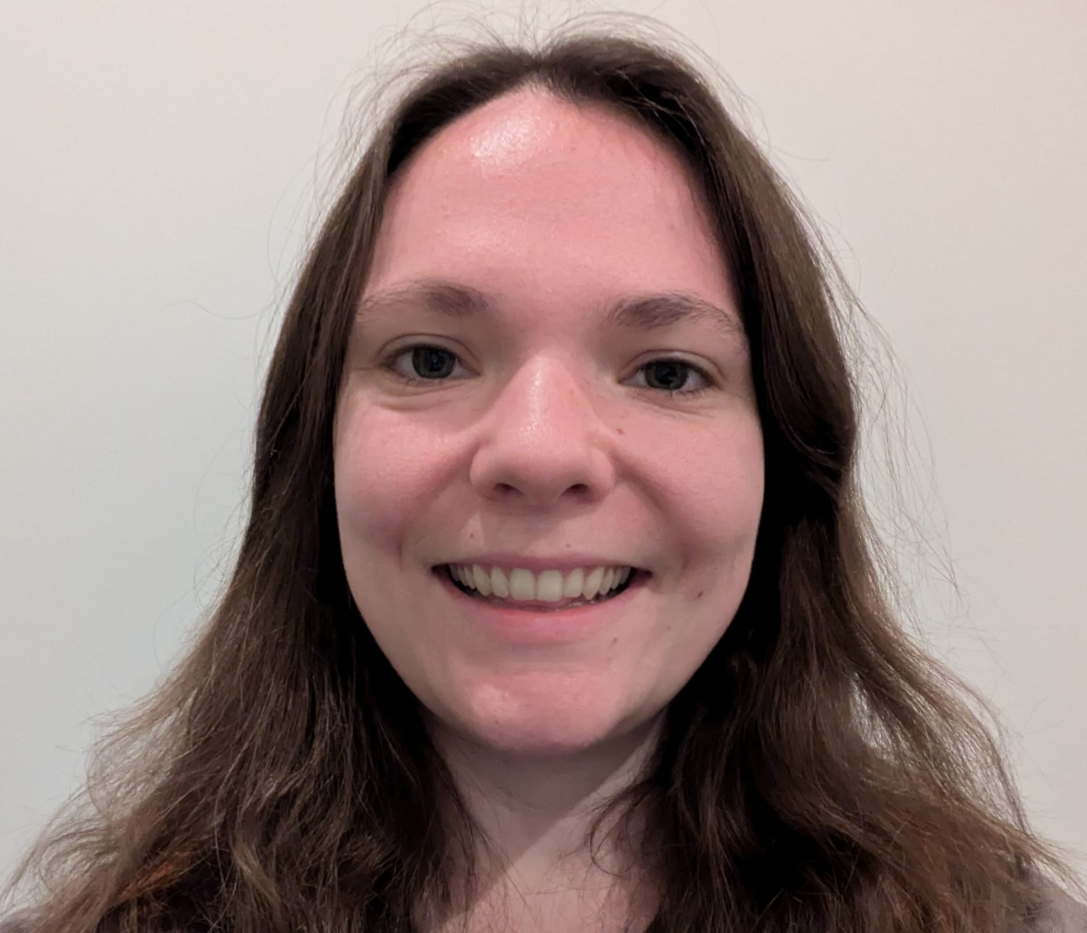
Careers after apprenticeships
Let's here from….
Claire Loveday
Sound No. 3
Les Miserables
Notes:
12.20
QUESTIONS TO ASK CLARE
What first attracted you to the technical theatre apprenticeship, and what made you choose that route over other career options?
Looking back at your apprenticeship, what were the most valuable skills, experiences or lessons you gained that still help you today?
What were the biggest challenges throughout your apprenticeship?
What was your first role after completing the apprenticeship, and how did you make the transition from apprentice to industry professional?
Can you talk us through the key steps, opportunities or decisions that helped you progress from your first role to where you are now?
What advice would you give to someone considering a technical theatre apprenticeship today who hopes to build a long-term career in the industry?

Slide 11
Break out rooms
Notes:
12.35 – 12.50 in room
12.50 – 55 – share some key highlights from room

Slide 12
The next six months…
Today
Apprentices Meeting
Employers Meeting
In Person Network event
Apprentices Meeting
Employer Meeting
Online Network event
Notes:
12.55
Meet Quarterly as full network
Meeting between for Apprentices and Employers

Slide 13
Thank you

